Slide 1
Talking Past Each Other Or To Each Other? Tracking Moral Divergence with DDR in Presidential Debates Over 60 Years
Mengyao Xu*, Lingshu Hu
* corresponding author, tel: 573 818 5156; email: mx3mt@mail.missouri.edu

Slide 2
Moral Foundation Theory (MFT) posits that human-beings are innately equipped with 5 moral foundations. Each foundation produces fast, automatic gut-reactions of like and dislike, which in turn guide judgments of right and wrong. People have different sensitivities of each moral foundation. Generally speaking, liberals are more sensitive to care/harm, fairness/cheating but very obtuse to the other three, and conservatives have even sensitivity across all five moral foundations.
Moral Dimensions | Liberals | Conservatives
care/harm | ● | ●
fairness/cheating | ● | ●
loyalty/betrayal | ● | ●
authority/subversion | ● | ●
sanctity/degradation | ● | ●

Slide 3
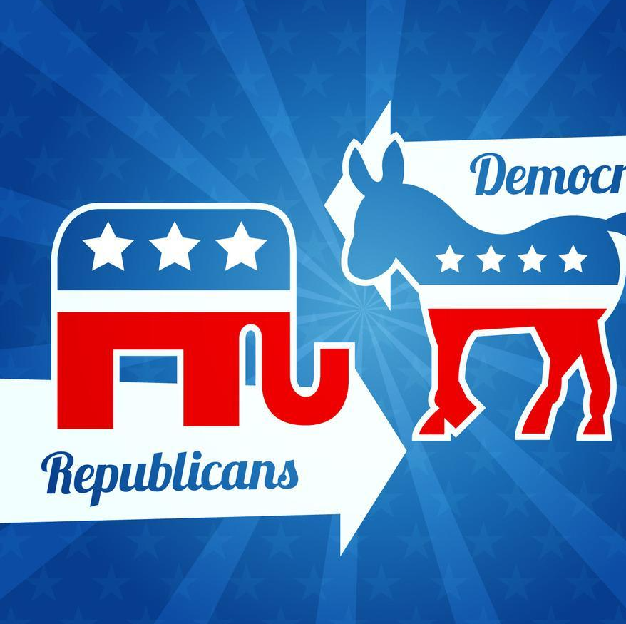
MFT researchers found:
Conservatives and liberals have a hard time seeing eye-to-eye because they have different moral configurations.
As for presidential debate: Lack of real clash!
H1: Democratic presidential candidates (relatively liberal) focus more on care and fairness moral concerns, therefore carrying more moral strength of these foundations in their arguments.
H2: Republican presidential candidates (relatively conservative) focus more on loyalty, sanctity, and authority moral concerns, therefore carrying more moral strength of these foundations in their arguments.

Slide 4
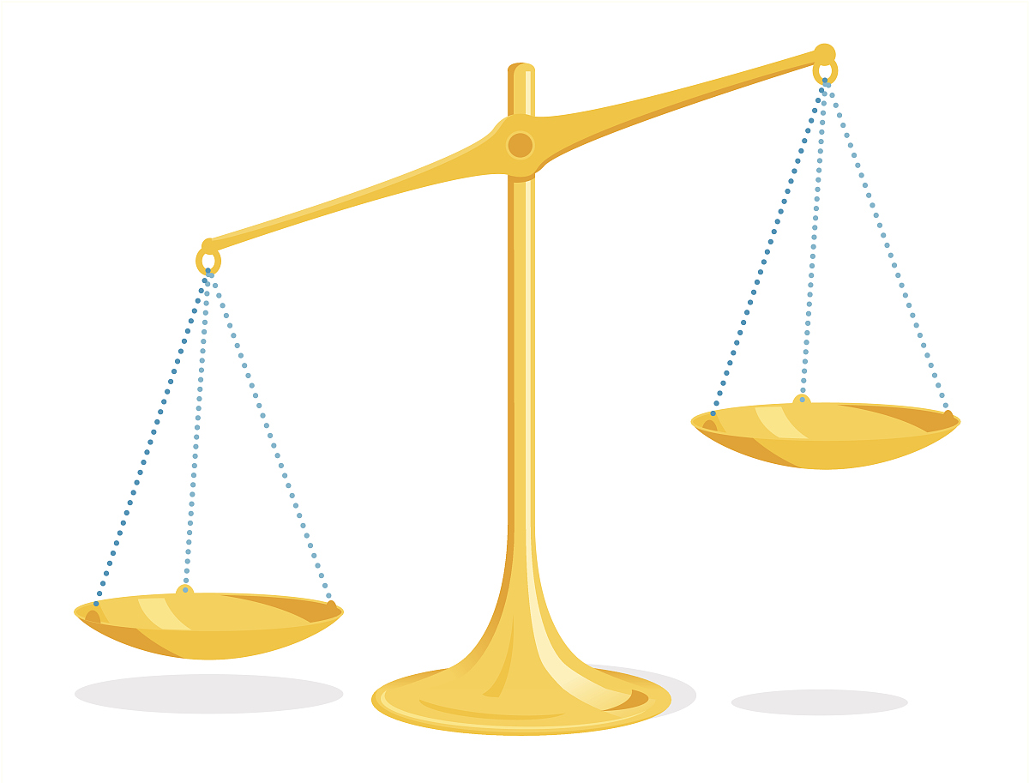
Mediatization Theory argues that media logic has been integrated into other social institutions such as politics, economy, culture, and so forth. The process of political mediatization is summarized as “personalization”, which entails that building personal image has become politicians’ top priority.
Issue
Image

Slide 5

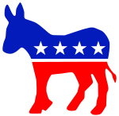
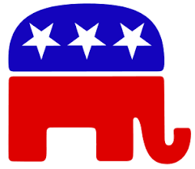
Building image (expressing themselves) is debaters’ top priority!
As presidential debate is a direct expression of debaters’ political attitude, presidential debaters may focus and emphasize different moral concerns generated from their own sensitive moral foundation.
An issue about care!
An issue about loyalty!
Moral divergence – a difference of moral judgement in terms of moral dimensions – may become one of the major barriers for liberals and conservatives to efficiently communicate with each other.
H3: The moral divergence between Democratic (relatively liberal) and Republican (relatively conservative) presidential candidates have been increasingly widened.
Issue

Slide 6
Method
This study conducted an automated content analysis to examine the moral strength of each presidential candidate’s full transcripts of 35 televised presidential debates of 13 presidential elections (1960-2020) with Distributed Dictionary Representations （DDR）
DDR
A recent developed algorithm.
Measure similarity between seed words from a psychological dictionary (Moral Foundation Dictionary in this study) and text by vectorizing every word.

Slide 7
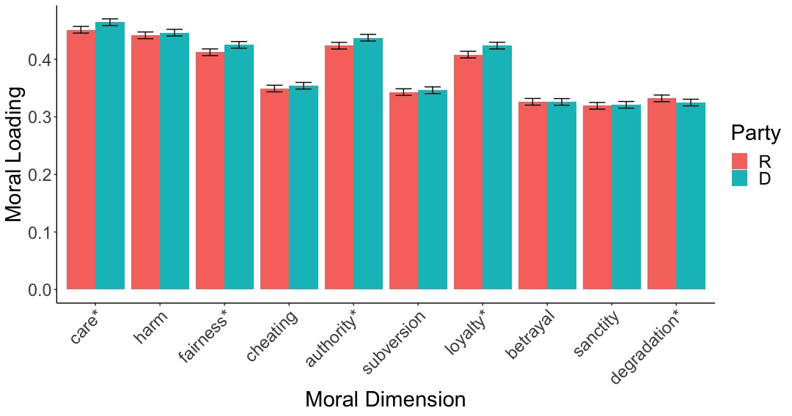
We found positive correlation among the moral strengths of each moral foundation in each candidate’s speech in every presidential debate. Almost every Democrat presidential candidate’s speech in the debates carried more moral strength than their Republican rivals across all five moral foundations.
We conclude
presidential debaters could understand, express, and respond to the moral concerns generated from their own less/non-moral foundations, which means that they could develop real issue discussion and engage in real clash with each other.
They could, but did they want to?
Figure 1 Moral Loads on Ten Moral Dimensions (Five Pairs).

Slide 8
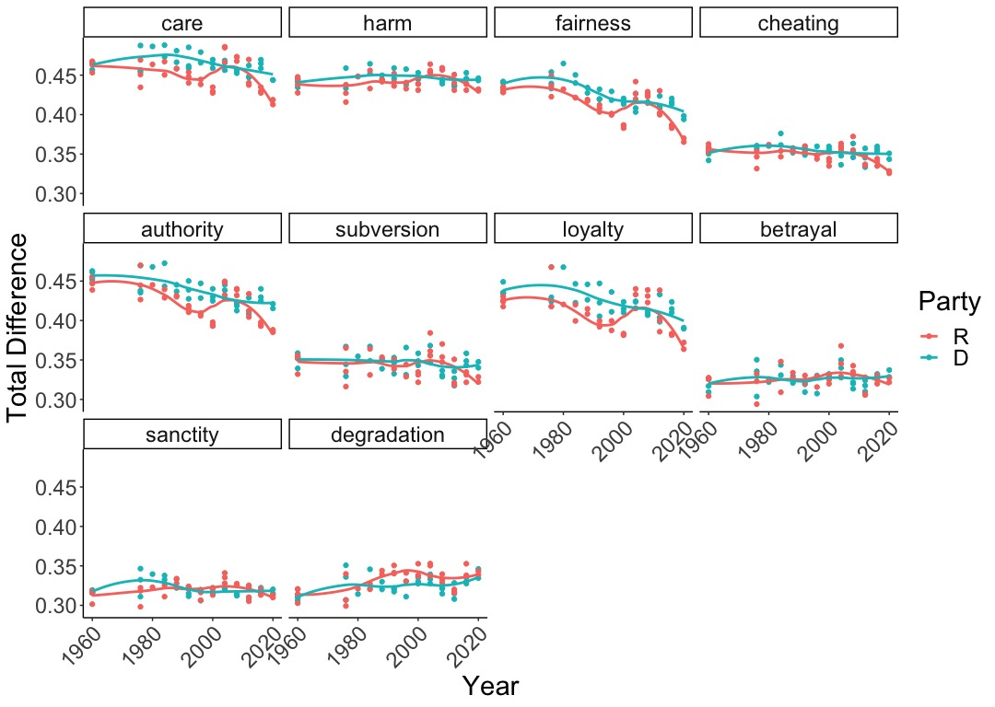
We found the moral divergence between Democrat and Republican candidates has been increasingly widened after 1980, indicating the acceleration of mediatization after the full launch of mediatization around 1980.
We conclude
presidential debaters may respond to moral concerns by elaborating his own moral concerns to build his own image rather than developing real issue discussion, exploring solutions, and finding a way for collaboration with each other.
It implies that political actors would outweigh media logic over political bargaining logic by prioritizing their own issue-stances and moral reasoning – personalization – in certain circumstances such as presidential debate, which could cause both positive and negative effects on democracy.
Figure 2 The Change of Democrats’ and Republicans’ Moral Load in Each Dimension Over Years.

Slide 9
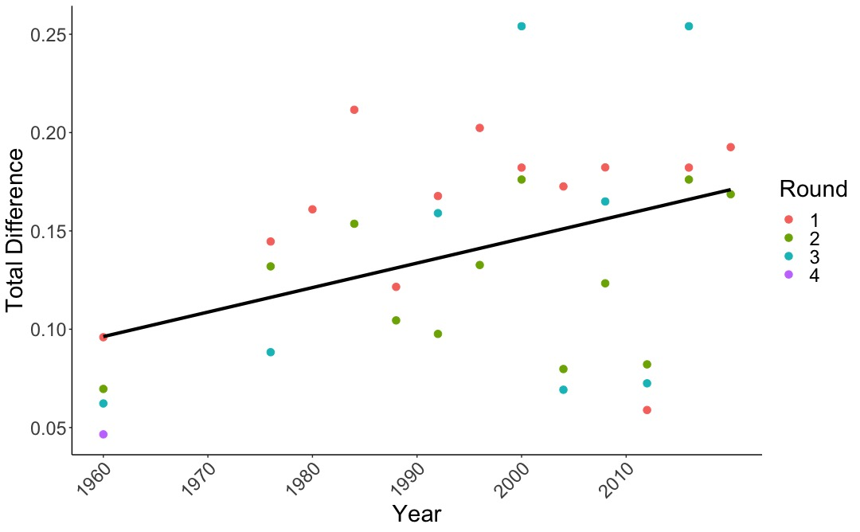
We found
the first round of debate usually had the highest difference score.
We conclude
Although mediatization in politics is inevitable as a long-term social change process, it is situational. That is, the degree of mediatization in politics varies according to different context and situations. Presidential candidates chose to abide to more media logic in the first debate, because the first debate is more important than its following debates because it usually attracts the highest viewership.
Figure 3 The Change of Total Moral Load Difference Over Years.

Slide 10
Thanks for your interest!

